Slide 1

NuSpace Internship (Feb – June 2022)
What did I do?

Slide 2
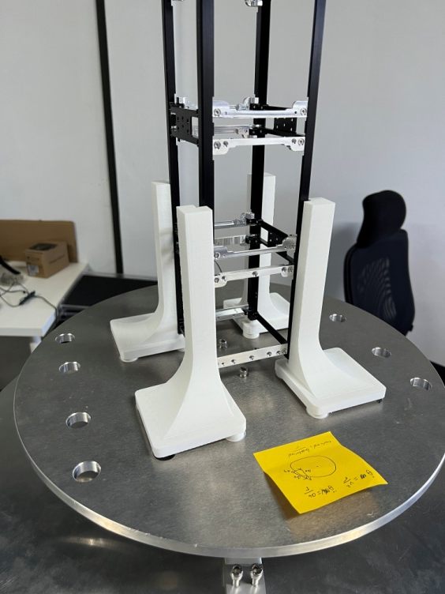
Main Mission: CGMOI machine
Integrated SPDT, DPDT relays and Arduino Mega to allow for reversible current supplied to linear actuators
Integrated 3 ADCs with 3 load cells and Arduino Mega to obtain mass and CG coordinates.
Set up a gyroscope with Arduino Mega to measure angular acceleration of rotation in order to calculate MOI.
Set up stepper motor, stepper motor driver and Arduino Mega to provide constant torque when measuring MOI.

Slide 3
Main Mission: CGMOI machine
Set up the power supply for the machine.
Designed and wrote an Arduino script with FreeRTOS to manage all the aforementioned components.
Learned KiCad and designed a PCB to stack ADCs, relays and Arduino Mega.
Picked up soldering to make wires and solder pins on PCB.
Learned SOLIDWORKS and designed a PCB enclosure which was then 3D printed.

Slide 4
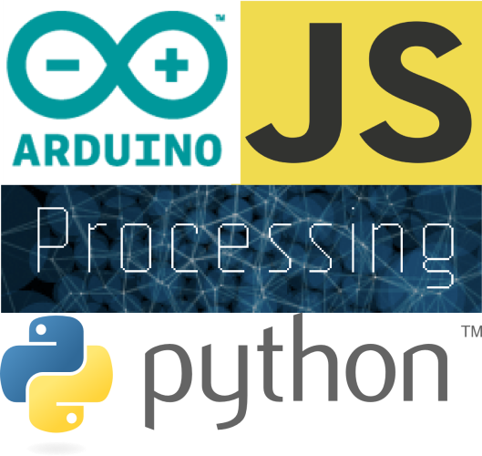
SIDE QUESTS
Taught a group of 20 CJC students about the basics of Python programming
Participated in the assembly of the clean room
Contributed to the assembly process of a nano-satellite by stripping and crimping wires
Learned how to use a logic analyzer

Slide 5
SIDE QUESTS
Create GitHub repository
Write readme using markdown
Learned about task manager

